Slide 1
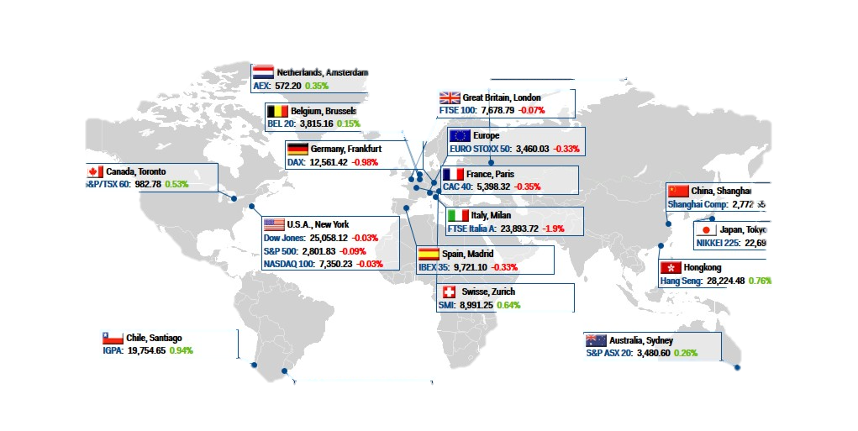

U.S. News VS. GLOBAL STOCK MARKETS
BY: JUSTIN JOHN, FARAH AWAD, STEPHEN BERNARD

Slide 2
Core Questions
How do global stock markets fluctuate based on the sentiment analysis of New York Times’ various headlines on Business, Finance, Politics and Foreign news?
Markets to predict daily percent change - SP500(USA), FTSE 100(UK), FCHI CAC 40(FR), GDAXI(GER), TOPIX (Japan)
How are major global markets going to perform in the next 5 trading days?

Slide 3
Machine Learning Models & NLP Kits
Balanced Forest Classifier Model
Target: classifying increase or decrease of percent change of an index based on features
Features: includes sentiment and emotion analysis of lead paragraph and headlines from New York Times
Long-Short-Term Memory RNN Model
Target: predicting close price and percent change of each index for the next 5 days
Features: includes sentiment and emotion analysis of lead paragraph and headlines from New York Times
IBM Watson NLP
Used to analyze emotion and sentiment from U.S. news.
We scored news (specifically lead paragraphs & headlines) for 3 months on:
Negative/Positive Sentiment
Emotions: Fear, Sadness, Disgust, Joy & Anger

Slide 4
Data Sources & Model Training
Data Sources:
New York Times News API (3-months)
Stock Market Data: Google Finance (3-months)
Exploration and Cleanup Challenges
It was a challenge finding a reliable global stock data resource
Reshaping the data in order to use a 5-day window for the LSTM model
Pulling the correct amount of data to train a reliable model
Model Training Challenges & Callouts
Choosing the correct number of EPOCHS,
Deciding on the number of layers for the LSTM model
Exploring different loss functions and metrics
Having multiple targets

Slide 5
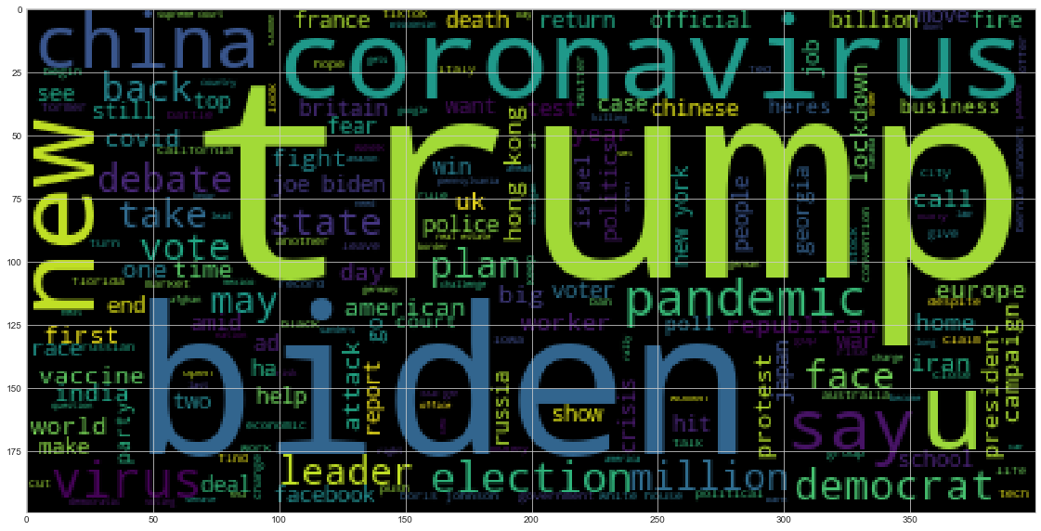

Features: Natural Language Processing
We scored news from NYT (specifically lead paragraphs & headlines from articles) for the last 3 months on:
Negative/Positive Sentiment
Emotions: Fear, Sadness, Disgust, Joy & Anger

Slide 6
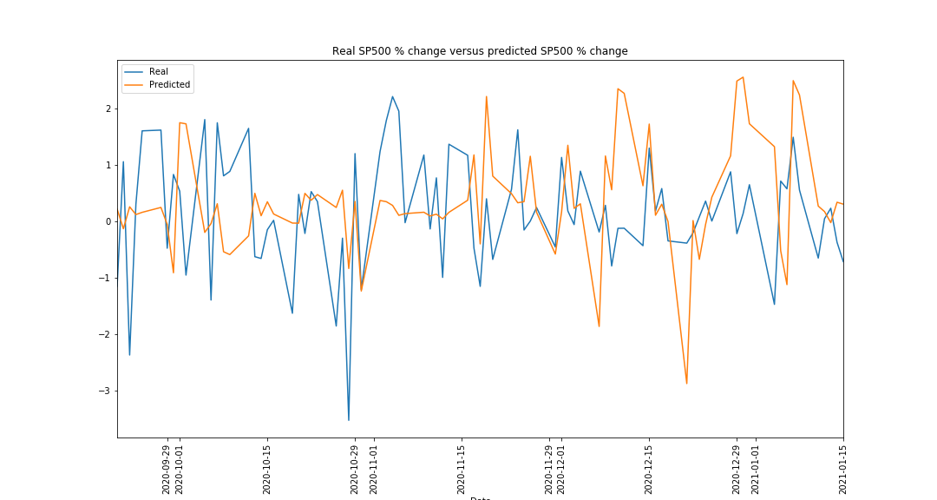
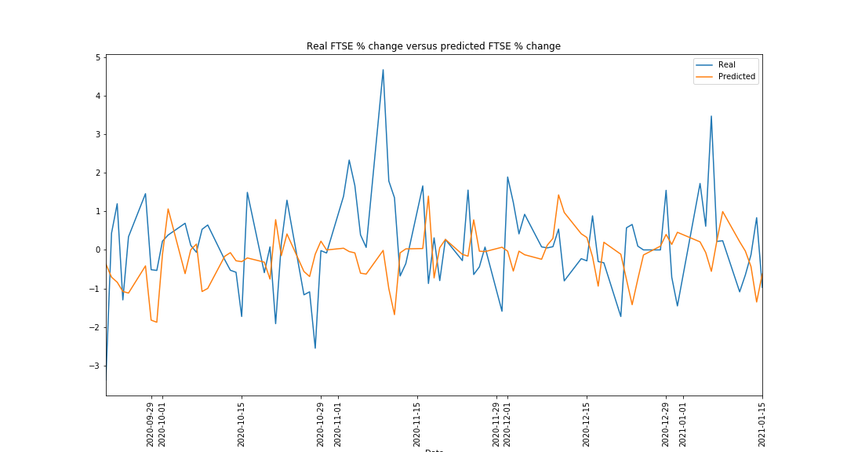
Results: Percent change
LSTM Model: MSE loss function

Slide 7
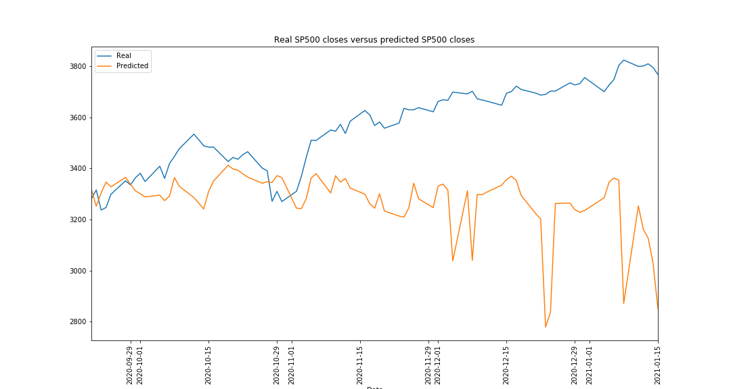
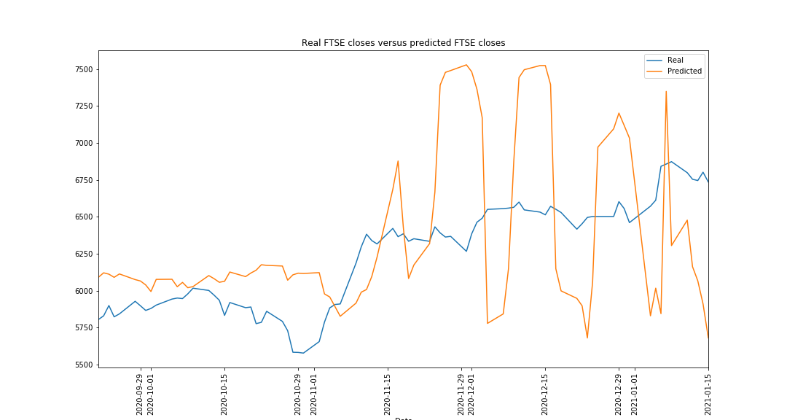
Results: Close Price
LSTM Model: MSE loss function

Slide 8
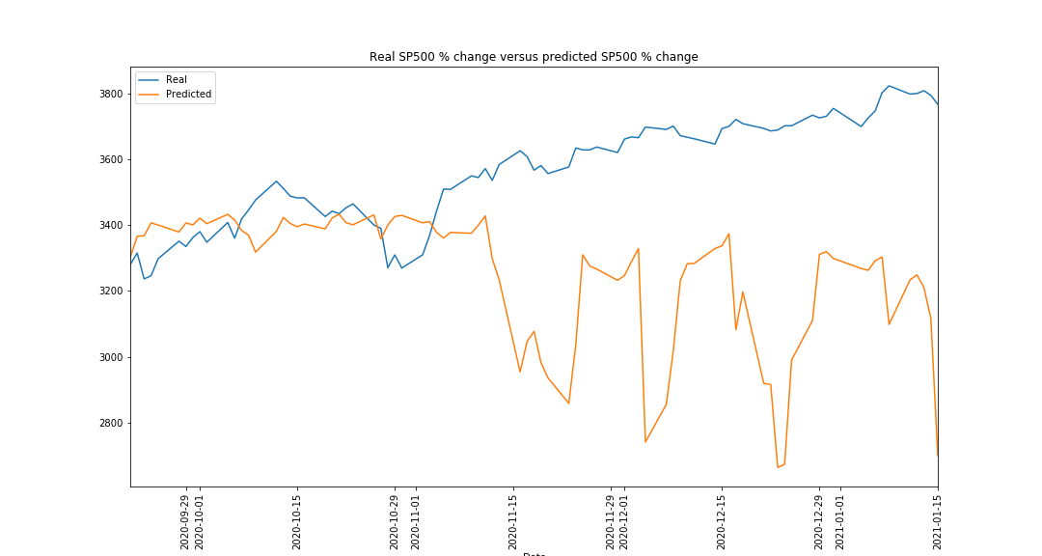
Log cosh
Mean squared error

Slide 9
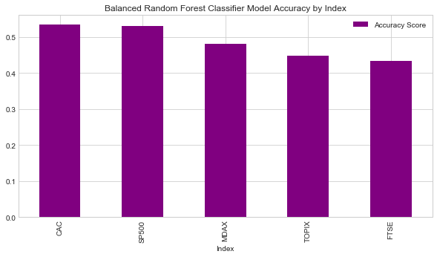
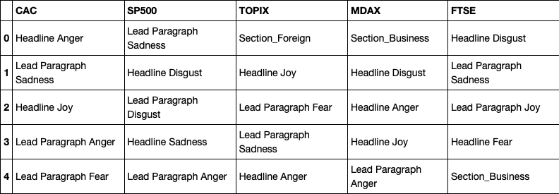
Evaluation Metrics
Balanced Random Forest Classifier Model
Top Five Emotions (by Index)
France
US
Japan
Germany
UK

Slide 10
Evaluation Metrics: Classification Model
 | CAC | FTSE | MDAX | S&P 500 | TOPIX
Accuracy | 0.53 | 0.43 | 0.48 | 0.53 | 0.45
Precision | 0.55 | 0.44 | 0.50 | 0.55 | 0.45
Recall | 0.52 | 0.43 | 0.48 | 0.52 | 0.45
True Positives | 22 | 17 | 25 | 23 | 19
True Negatives | 22 | 19 | 16 | 21 | 19
False Positives | 13 | 18 | 18 | 14 | 25
False Negatives | 28 | 31 | 26 | 27 | 22

Slide 11
LSTM RNN: Loss function comparison
Mean squared error
 | CAC | FTSE | MDAX | S&P 500 | TOPIX
Close | 0.1195 | 0.1677 | 0.1335 | 0.2237 | 0.2036
Percent Change | 0.0417 | 0.0213 | 0.0197 | 0.0154 | 0.0224
Log Cosh
 | CAC | FTSE | MDAX | S&P 500 | TOPIX
Close | 0.0690 | 0.0563 | 0.0879 | 0.1381 | 0.0832
Percent Change | 0.0167 | 0.0149 | 0.0125 | 0.0126 | 0.0185

Slide 12
Conclusion/Postmortem
We discovered that the news source New York Times’ (Headlines and Lead Paragraph) was heavily negative sentiment when doing NLP.
We didn’t see much of a correlation between U.S. news and global stock market indices.
Looking at the Top Five Emotions for each index, majority of the emotions are negative.
Can be a timing issue of the scope of the project (10/13– 1/13)
We should’ve used more news sources (Bloomberg, CNBC or Wall Street Journal) to get varying news opinions rather than just the NYT.

Slide 13

Any Questions?

